Slide 1
Capstone Project The Battle of Neighborhoods Report
Sushma Danturi

Slide 2
Introduction
Background
This projects vision is to make it even more easier for individuals to take decision of which borough to choose to live in the city.
Business Problem
The objective of this Capstone Project is to analyse and choose the safest borough in the New York City based on the total crimes.
Who will use it?
People moving to this new place to make a decision of which location is safe and will be suitable for there preferences.

Slide 3
Data Description
Sources
NYPD Crime data
https://data.cityofnewyork.us/Public-Safety/NYPD-Complaint-Data-Historic/qgea-i56i
Boroughs
https://www.citypopulation.de/en/usa/newyorkcity/
Neighborhood
https://geo.nyu.edu/catalog/nyu_2451_34572

Slide 4
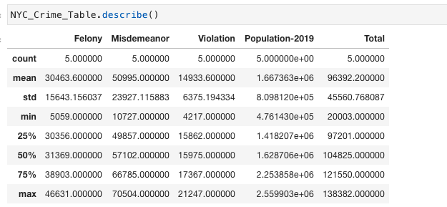
Methodology
Exploratory Data Analysis
Statistical Summary.

Slide 5
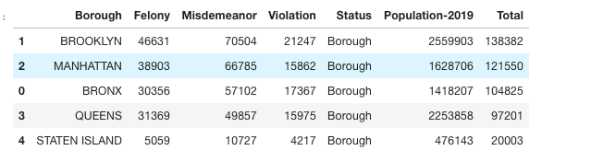
Methodology
Exploratory Data Analysis
Merging the Data.

Slide 6
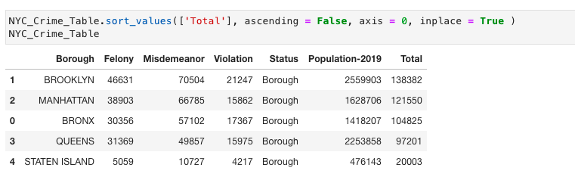
Methodology
Exploratory Data Analysis
Comparing the Boroughs for highest crime rate.

Slide 7
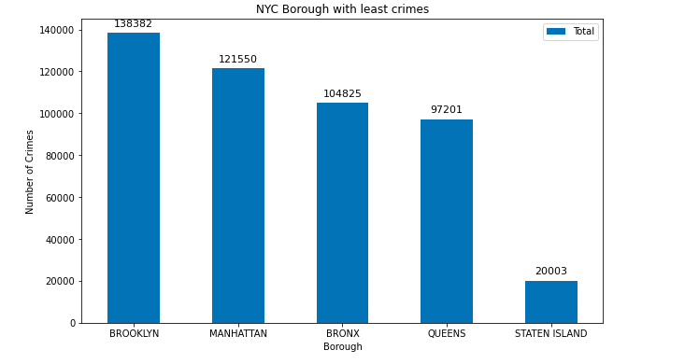
Methodology
Exploratory Data Analysis
Analyzing the safe borough

Slide 8
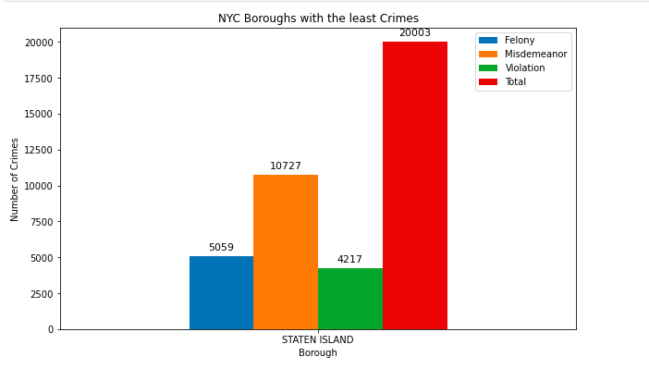
Methodology
Exploratory Data Analysis
Showing the different crimes in Staten Island

Slide 9
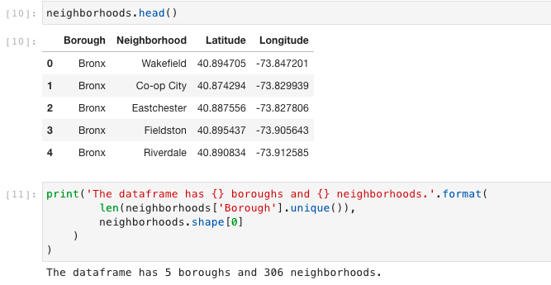
Data Segmenting and Clustering

Slide 10
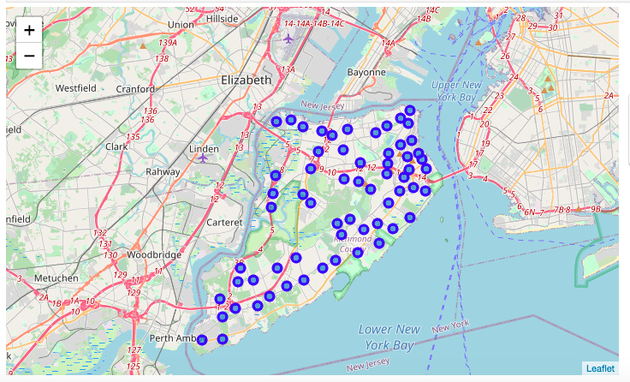
Data Segmenting and Clustering
Exploring the Neighborhood of Staten Island

Slide 11
Data Segmenting and Clustering
Utilizing the FourSquare API for exploring the Venues.
Radius as 500
Limit of venues to be 100.

Slide 12
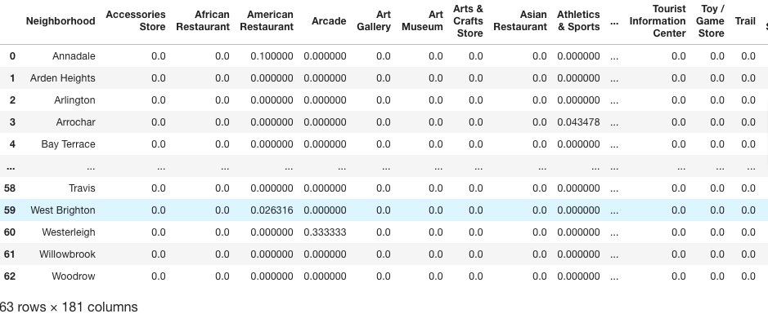
Data Segmenting and Clustering
Analyzing each Neighborhood of Staten Island

Slide 13
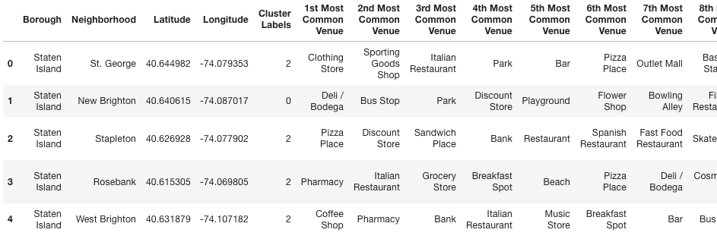
Data Segmenting and Clustering
Clustering of the Neighborhood

Slide 14
Results
The vision of this project is to help individuals/families who want to relocate to the safest borough in New York City
Anyone can explore the neighborhoods to which they want to relocate based on the most common venues in it.

Slide 15
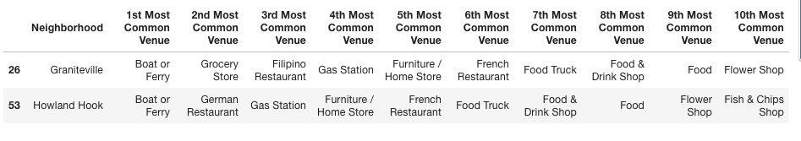
Discussion
Cluster 2

Slide 16
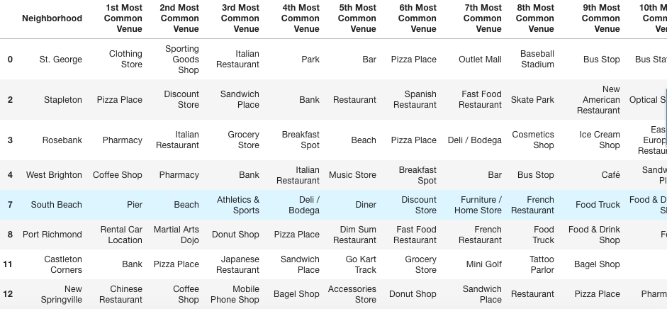
Discussion
Cluster 3

Slide 17
Conclusion
This project gives better understanding to the neighborhoods in terms of the crimes occurring in the borough.
The most common venues in that neighborhood.
Safety is considered as a primary concern of everyone and has shortlisted to the safest borough in New york city.
The most common places in the neighborhoods to present the different clusters to choose according to once preferences.

